Slide 1
TIME ANALYSIS
IMPLEMENTATION IN C
s/e | frequency | total steps
1 | 1 | 1
1 | 1 | 1
0 | - | -
1 | 1 | 1
1 | 1 | 1
1 | 1 | 1
1 | 1 | 1
1 | n+1 | n+1
0 | - | -
1 | n | n
0 | - | -
1 | n | n
1 | n | n
#include<stdio.h>
void printMaxEvents(int s[ ], int f[ ], int n)
{
int i, j;
printf ("Following events are selected n ");
i = 0;
printf("%d ", i);
for (j = 1; j < n; j++)
{
if (s[ j ] >= f[ i ])
{
printf ("%d ", j);
i = j;

Slide 2

s/e | frequency | Total steps
0 | - | -
0 | - | -
0 | - | -
1 | 1 | 1
0 | - | -
1 | 1 | 1
1 | 1 | 1
1 | 1 | 1
1 | 1 | 1
1 | 1 | 1
1 | 1 | 1
0 | - | -
1 | n+1 | n+1
1 | n | n
0 | - | -
1 | 1 | 1
1 | 1 | 1
}
}
}
int main()
{
int n,i;
printf("Total number of events :");
scanf( "%d", &n);
int s[ n ] ,f[ n ];
printf("s[ ] --> An array that contains start time of all events\n");
printf(" events should already sorted according to their finish time\n
");
for (i = 0; i < n; i++){
scanf("%d", &f[ i ]);
}
printMaxEvents(s, f, n);
return 0; }
Your text has been concise and beautiful, but the information is

Slide 3
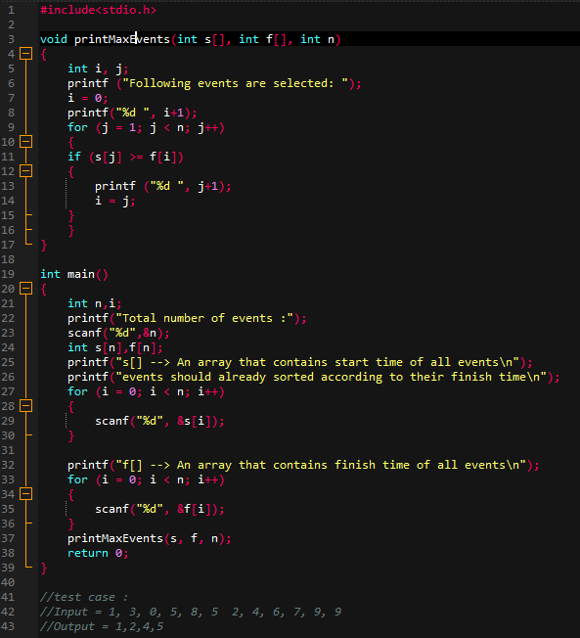
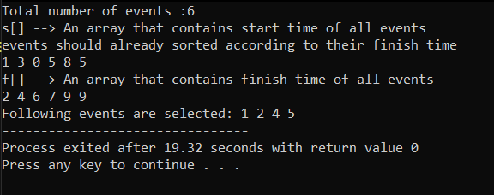
Total Steps = 6n + 17
Time Complexity : O(n)
Input : s[ ] = {1, 3, 0, 5, 8, 5};
f [ ] = {2, 4, 6, 7, 9, 9};
Output : 1,2,4,5
Compiler Output:
Link (.cpp file): https://drive.google.com/file/d/1GVU2VBo5pffNIZX26Lu21e84mKJ3MiF0/view?usp=sharing

Slide 4


Thank You

